Slide 1
From the Arab World to Silicon Valley
Sept.
8–14
2016
3rd––––––– edition

Slide 2
About MIT Enterprise Forum Pan Arab
Launched in 2005, the MIT Enterprise Forum of the Pan Arab Region is one of the 28 international chapters of the Boston-based MIT Enterprise Forum Global, an avid promoter of entrepreneurship and innovation worldwide affiliated with the prestigious MIT University.
With offices in Beirut, Dubai and Jeddah, our mission is to develop and nurture a culture of entrepreneurship across the Arab region.

Slide 3
What we do?
We inspire
through the annual MIT Enterprise Forum Arab Startup Competition (ASC).
We promote
entrepreneurs in international media and through our Silicon Valley program.
We foster science and technology
through our media arm MIT Technology Review Arab Edition.

Slide 4
What is the Silicon Valley Program?
Launched in 2014, the Silicon Valley program falls under one of the key missions of our organization:
Promote startups from the Arab World on an international level
Strengthen the entrepreneurial image of the Arab World
For the past 3 years, we have been providing critical support to around 20 startups from various sectors by flying them to Silicon Valley for a week-long immersive program during which entrepreneurs participate in leading tech conferences, undertake trainings and are offered opportunities to meet with mentors and pitch their startups to industry leaders, investors and successful entrepreneurs.

Slide 5
What do we offer the startups?
training
mentorship
pitching
networking
startup showcasing
media exposure

Slide 6
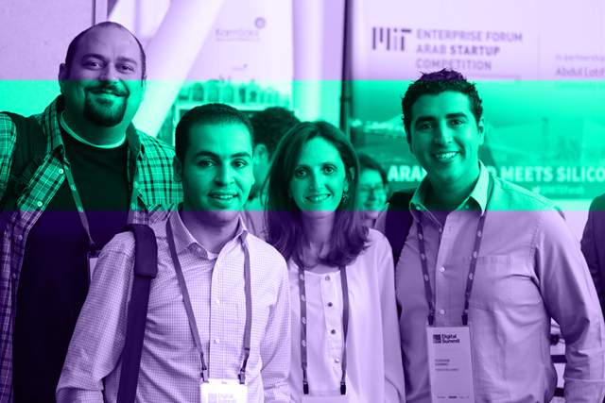
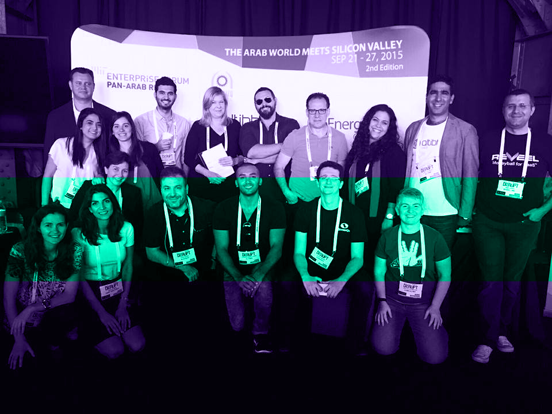
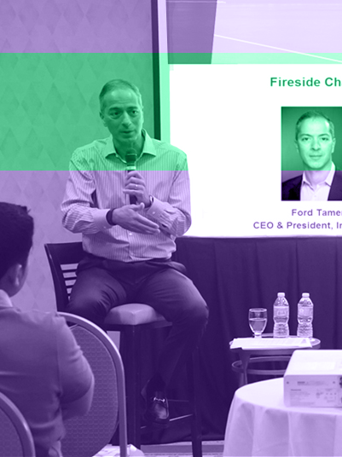
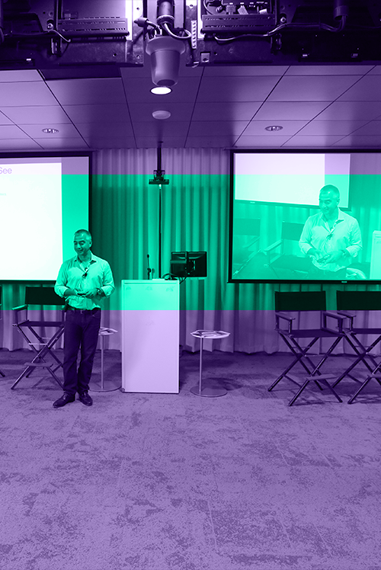
Overview of the last 2 editions
2014
2015
2014
2015

Slide 7
2016 Edition
The 11 Teams

Slide 8
2016 Edition
Teams Profiles
Arrow Labs is a mobility software manufacturer specializing in niche applications and mobility solutions. Arrow Labs MIMS is a state of the art mobility platform designed for todays modern workforce.
Evam provides a next generation business oriented streaming analytics platform for customer engagement and operational intelligence. Their platform is a real time event-processing solution capable of sensing, analyzing and acting on events as they are produced. EVAM can process millions of events in seconds and can take action to capture opportunities and prevent threats.

Slide 9
2016 Edition
Teams Profiles
Arrow Labs is a mobility software manufacturer specializing in niche applications and mobility solutions. Arrow Labs MIMS is a state of the art mobility platform designed for todays modern workforce.
Linkry is a one stop shop for event organizers, providing services from online registration, check-in and badge printing, to mobile event applications and real time analytics.

Slide 10
2016 Edition
Teams Profiles
Liwwa delivers jobs and income growth in the markets they serve. The way they do that is by facilitating capital access for small businesses - a $250 billion gap in the Middle East alone.
Mondo Ride allows users to order cars with a single click and move around the city in the safest way possible, with the most reliable drivers, and at the lowest fares. Mondo Ride app has unique features not offered by any similar service.

Slide 11
2016 Edition
Teams Profiles
NAR is designing and developing drone-based solutions allowing current drones on the market to analyze and interpret data on the fly for real-time updates of safety-critical applications in the Wildfires and Oil & Gas sectors, to promote rapid responses. NAR's drone solution enables the cost-effective, fast and safe monitoring of long pipelines for leakages and corrosion as well as large and hard to reach forest areas for potential hotspots.
Myki is an enterprise mobile solution that eliminates the need for usernames and passwords. myki is the future of identity management.

Slide 12
2016 Edition
Teams Profiles
Pixelbug offers world class augmented reality technology apps from the hub of the Middle East. Pixelbug is a Dubai based company and is composed of a multi-cultural team with international experience.
Proximie aims to revolutionise the way surgeons work and educate through augmented virtual guidance. Using the latest advances in technology, our platform enables consultations to be provided remotely, both locally and globally.

Slide 13
2016 Edition
Teams Profiles
Wrappup is a smart voice recorder that allows you to summarize your meetings and makes your meeting discussions easily searchable.

Slide 14
Saudi Teams
Guest startups

Slide 15
Program September 8-14, 2016
Day 1 | Sep 8
Training & Meeting Industry Experts
@ Google HQ
Day 2 | Sep 9
Meeting Investors
@ 500 Startups
Day 3 | Sep 10
Tour in Silicon Valley
Day 4 | Sep 11
Day Off
Day 5–7 | Sep 11-14
MITEF Arab Pavilion at TechCrunch Disrupt

Slide 16
Program Sept. 8th | Day 1 | @Google HQ
8:30 am | 9:00 am
Registration, followed by a Welcome Address
Hala Fadel, Chairperson, MITEF Pan Arab
George Akiki, President, LebNet
9:00 am | 1:00 pm
Training on Pitching
Andrea Barrica, Venture partner, 500 Startups
1:00 pm | 2:00 pm
Networking Lunch
2:00 pm | 5:00 pm
Meetings with Industry Experts
5:00 pm | 6:00 pm
Speed Networking

Slide 17
Program Sept. 9th | Day 2 | @500Startups SF
8:00 am | 8:30 am
Coffee Break, followed by an Introduction of the day
Hala Fadel, Chairperson, MITEF Pan Arab
Startups Pitch to 500Startups Investment Team
8:30 am | 9:30 am
Tour of 500Startups
9:30 am | 10:00 am
Break
10:00 am | 11:00 am
11:00 am | 12:00 pm
Keynote Speech
Amr Awadallah, Founder & CTO, Cloudera
Networking Lunch
12:00 pm | 1:00 pm
2:00 pm | 5:00 pm
One-to-One Meetings with Investors

Slide 18
Program Sept. 10th | Day 3 | Tour in Silicon Valley
Program Sept. 11th | Day 4 |
Day Off

Slide 19
Program Sept. 12th – 14th | Day 5 – 7
9:00 am | 5:00 pm
MITEF Arab Pavilion @ TechCrunch Disrupt SF
Entrepreneurs showcasing their companies
Venue: Pier 48, San Francisco, CA 94158
Register: https://techcrunch.com/event-info/disrupt-sf-2016/

Slide 20
Thank you
Strategic Partners
Supporting Partners

